Slide 1
Adult Salary Prediction
Presented by:
Omran Fallatah
Ghanim Alghanim

Slide 2
Data Gathering

Slide 3
Data Gathering
The dataset was collected from UCI machine learning repository
The dataset contains ~50,000 observation and 16 features
Target filed: Income

Slide 4
Data Cleaning

Slide 5
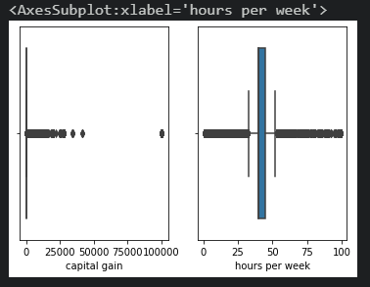
Data Cleaning & Feature Engineering
A lot of outliers
Convert categorical into maps and one hot encoding
Dropping missing data that can’t be filled due to lack of data.

Slide 6
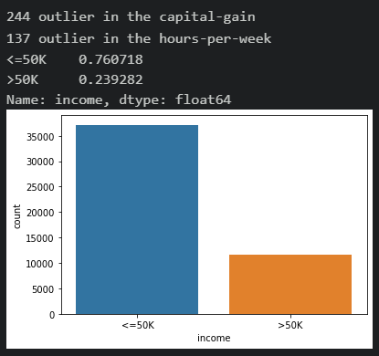
Pre-Model Fitting
Unbalanced data
Used SMOTE to fill the least filled target
Used MinMaxScaler to normalize the data

Slide 7
Models

Slide 8
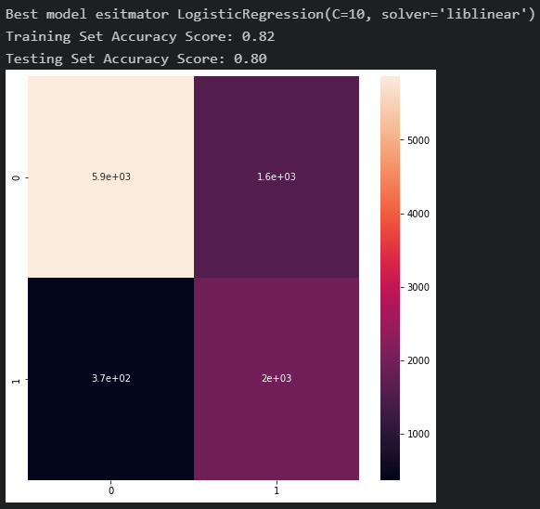
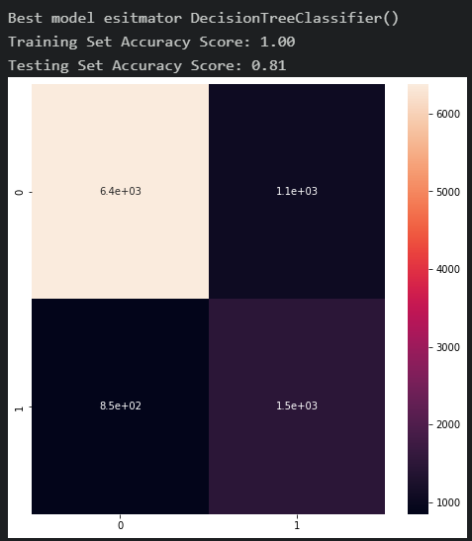
Logistic Regression Decision Tree

Slide 9
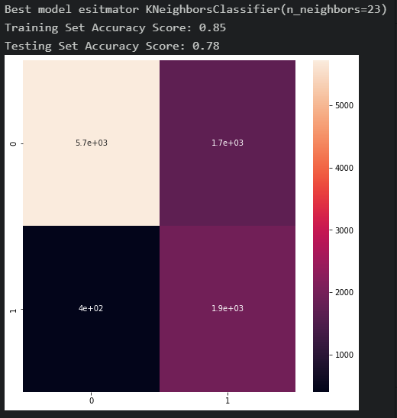
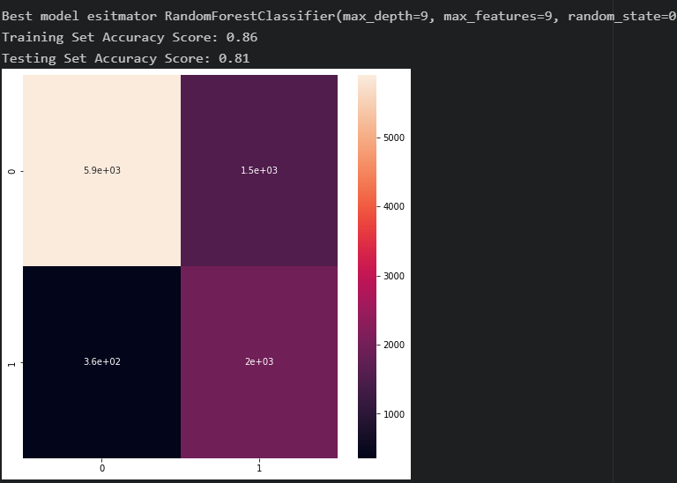
Random Forest K-Nearest Neighbors

Slide 10
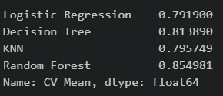
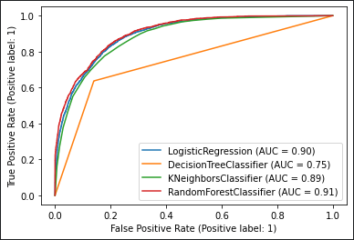
Cross Validation with 10 K folds
Best Model is Random Forest
with best R Squared Score 0.85

Slide 11
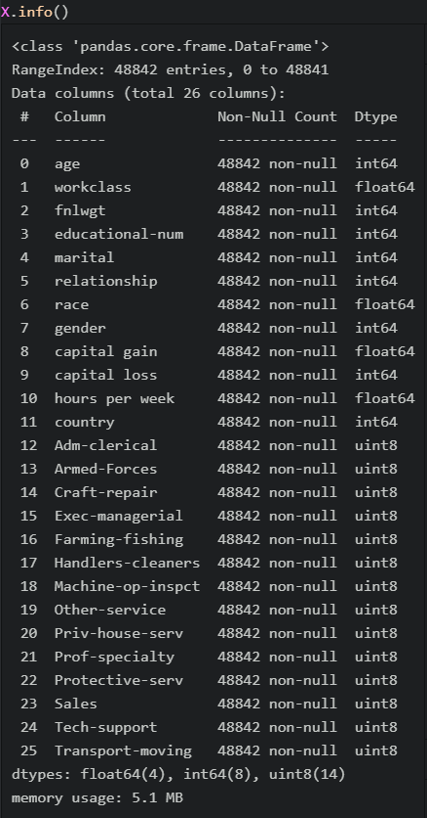
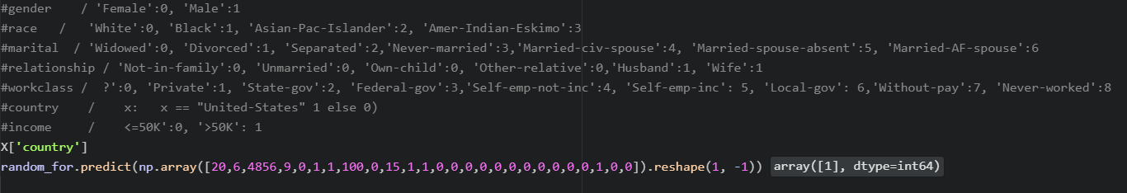
Prediction example

Slide 12

Thank you
Questions ?

